Slide 1

YWHO’s My Wellness Passport Coaching Series
Part 2:
Data Extraction + Data Requests
July 2022

Slide 2
Agenda
Extracting your Data
Limitations
Data Requests
Q&A

Slide 3



Meet the MWP Team
Mary Hanna
Project Manager
Elissa Pendergast
IT/DS Analyst aka
The Helpdesk Person
Nirupa Varatharasan
Evaluator
Notes:
EP to say:

Slide 4



Meet the MWP Team
Priyanka Sharma
Evaluator
Susan Le
Evaluator
Kathryn Sadowski
Evaluator
Notes:
EP to say:

Slide 5



Meet the MWP Team
Deb Chiodo
Director, Data Management and Evaluation, YWHO PO
Janis Wolfe
Clinical Consultant
Karleigh Darnay
Advanced Practice Clinical Leader
Notes:
EP to say:

Slide 6

How to extract data from MWP
Improve knowledge on extracting MWP data

Slide 7
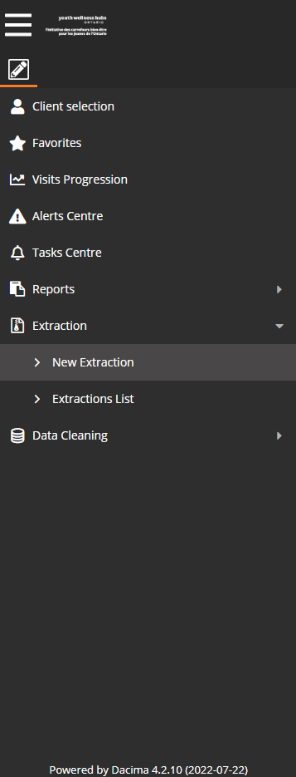
Extracting Data from MWP
  SuperUsers can:
  • Create and save extractions
  • Create email extractions on a prescheduled basis (one day, one week, and one month)

Slide 8
Extracting Data from MWP
  Let’s learn how to set up a new extraction!

Slide 9
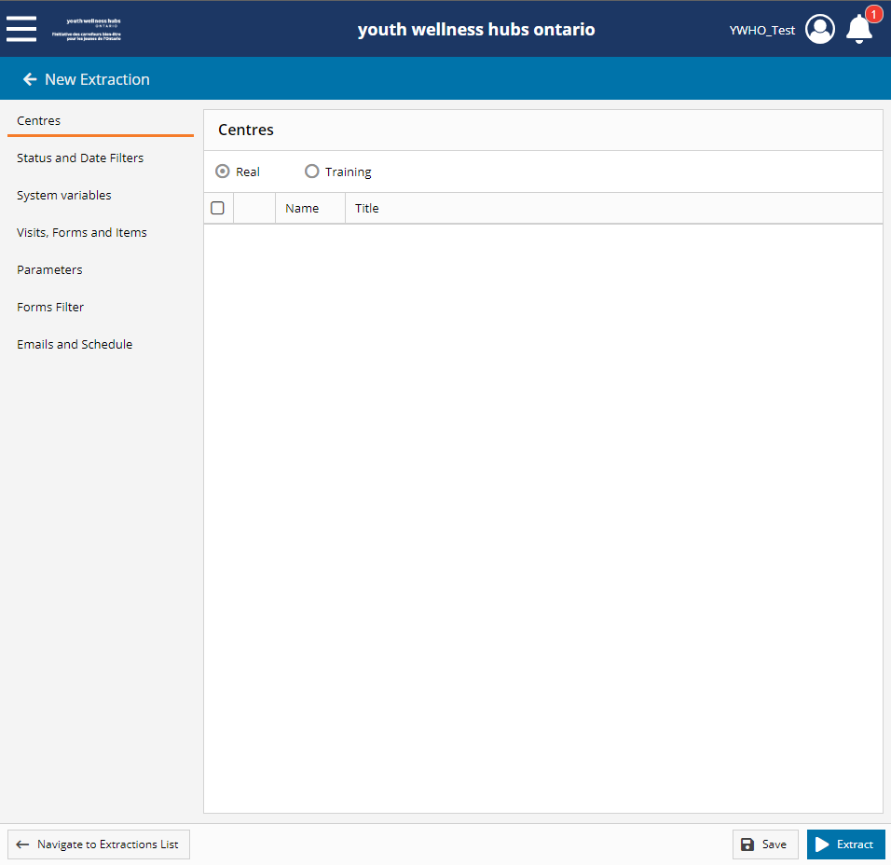
Extracting Data from MWP
  This test account (YWHO_Test) does not have access to real data
Notes:
EP to say:

Slide 10
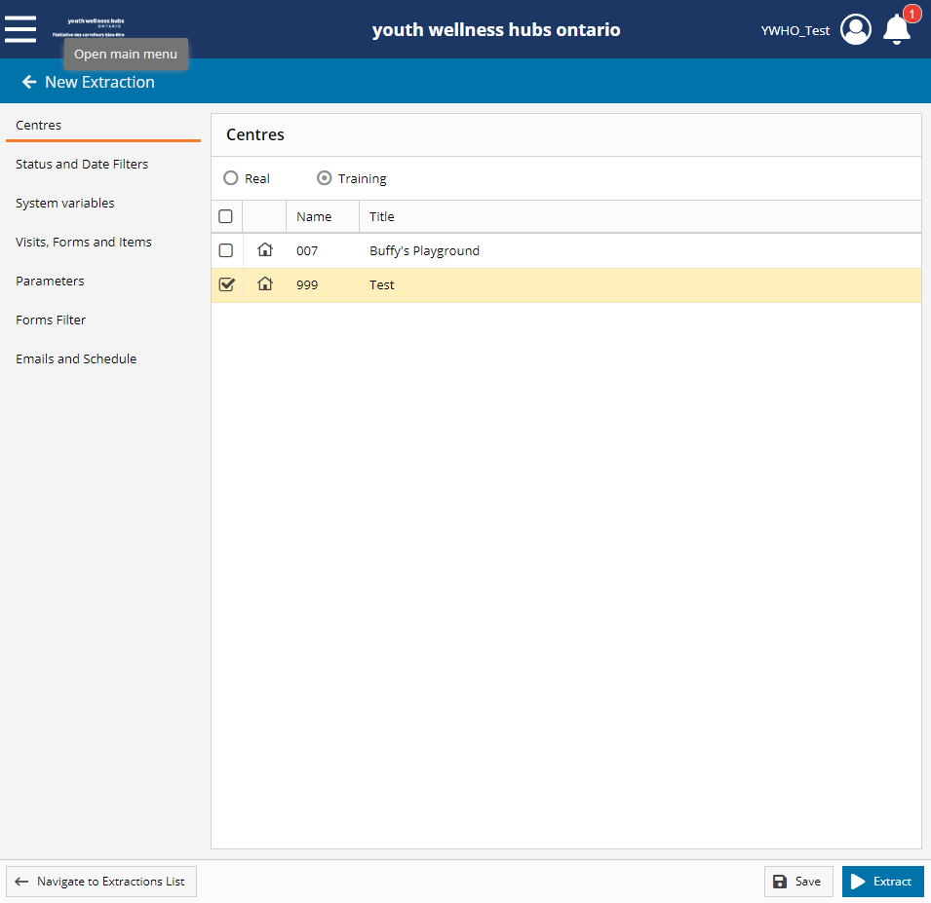
Extracting Data from MWP
  So we will be extracting data only from test centre
Notes:
EP to say:

Slide 11
Extracting Data from MWP
  Select the centre(s) you want to extract data from

Slide 12
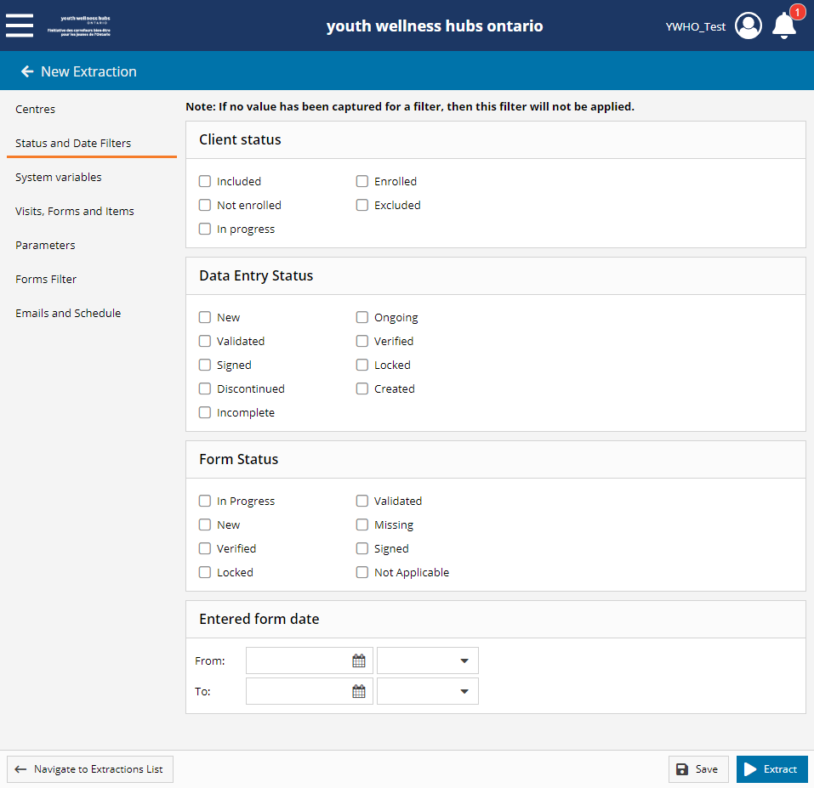
Extracting Data from MWP
  Once the centre(s) have been selected, in the extraction menu on the left side, select the “Status and Date Filters”

Slide 13
Extracting Data from MWP
  Client Status, Data Entry Status, and Form status can be left blank

Slide 14
Extracting Data from MWP
  If you are looking for data from a specific period

Slide 15
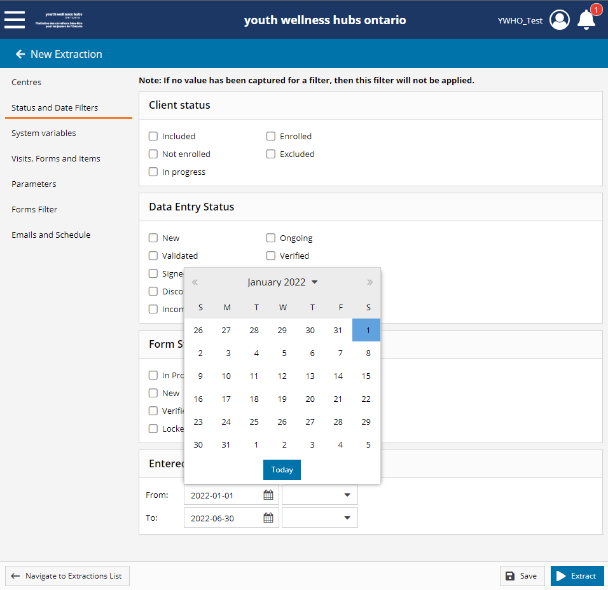
Extracting Data from MWP
If you are looking for data from a specific period

Slide 16
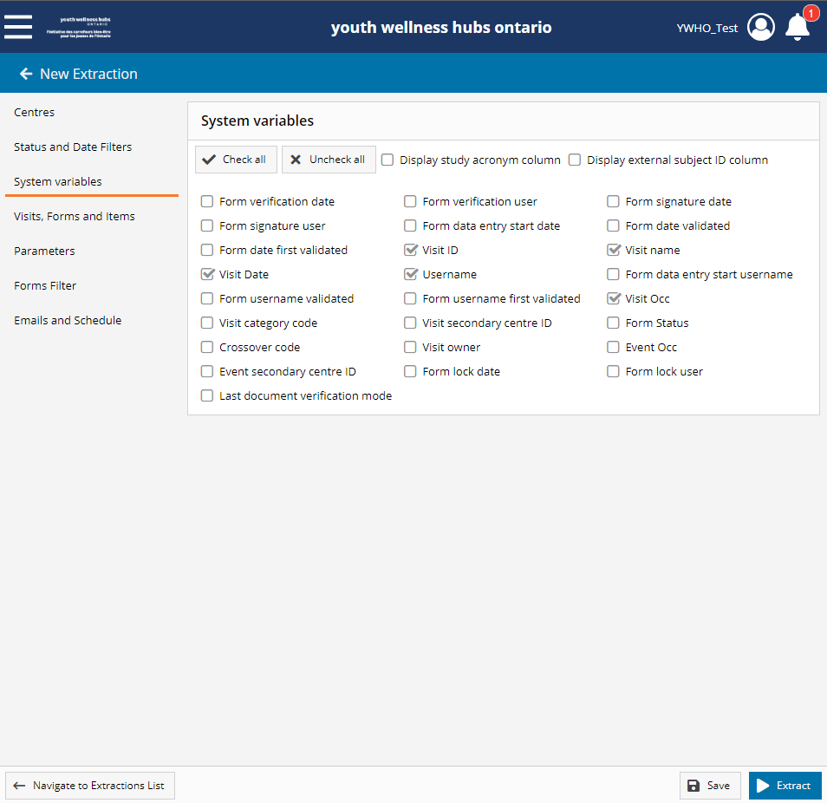
Extracting Data from MWP
In the System Variables are already preselected to best suit our work in Dacima
There is no need to select other system variabels

Slide 17
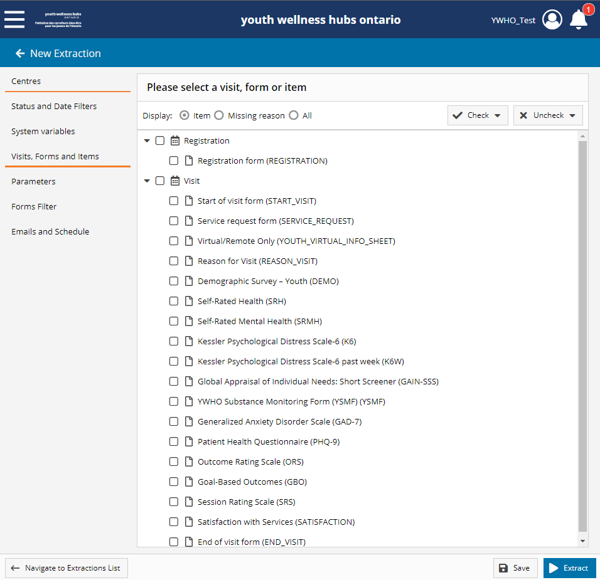
Extracting Data from MWP
In the Visit, Forms and Items, you can select entire forms, specific fields from various forms, or all items

Slide 18
Extracting Data from MWP
In the Visit, Forms and Items, you can select entire forms, specific fields from various forms, or all items
Display: item default
  Adding Missing Reason and/or All is not applicable to MWP

Slide 19
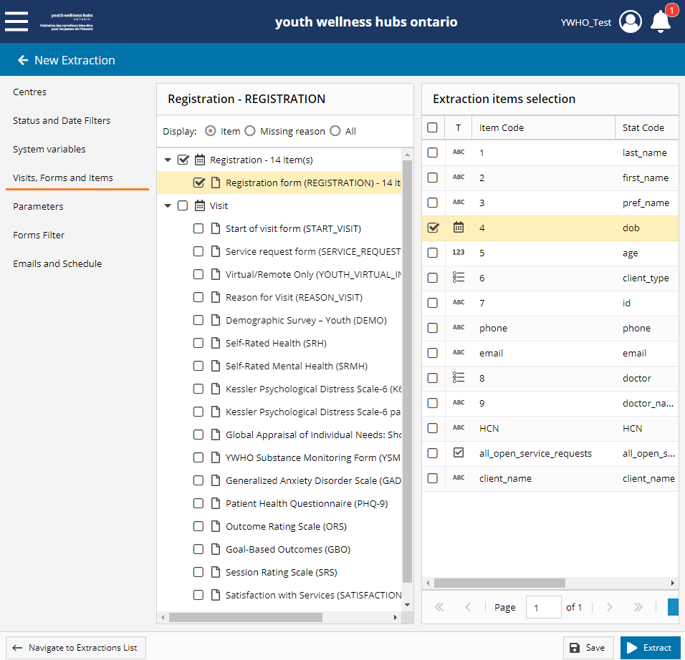
Extracting Data from MWP
The most common items extracted:
  Date of birth in the Registration Form

Slide 20
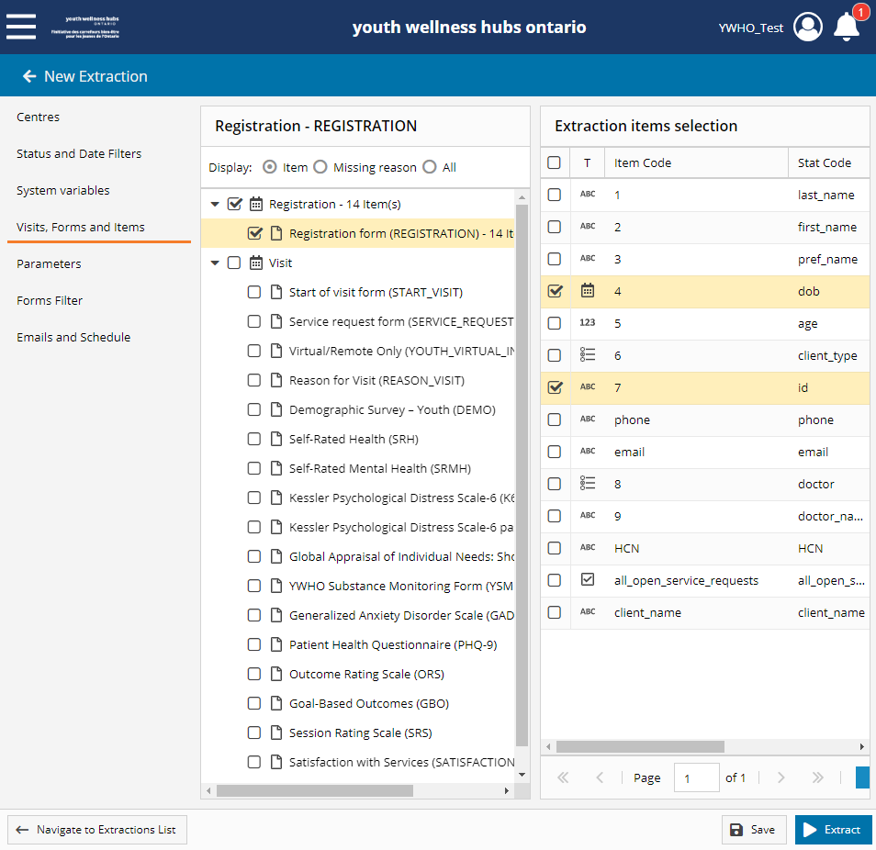
Extracting Data from MWP
The most common items extracted:
  Date of birth in the Registration Form
  Client ID

Slide 21
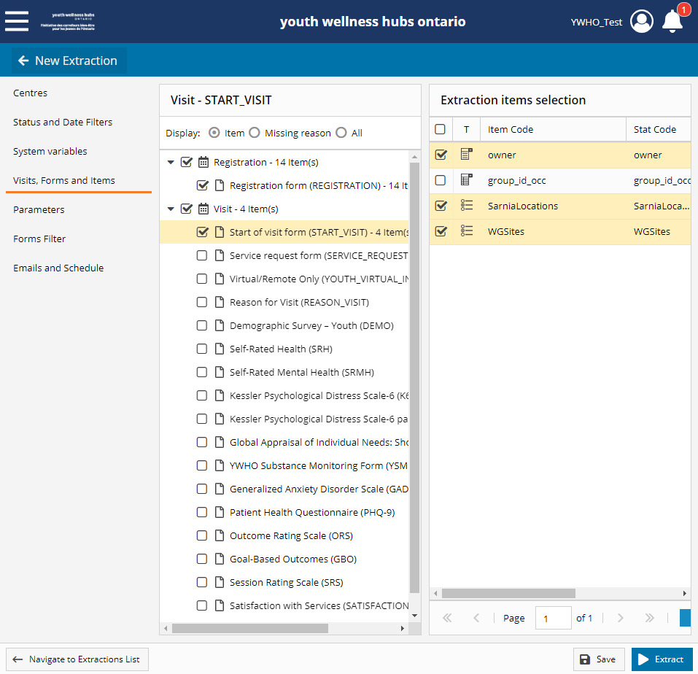
Extracting Data from MWP
The most common items extracted:
  In the Start of Visit Form, the visit provider that would have seen the youth for that visit
  If your hub has multiple sites, you can select this item to refine your data to location specific data

Slide 22
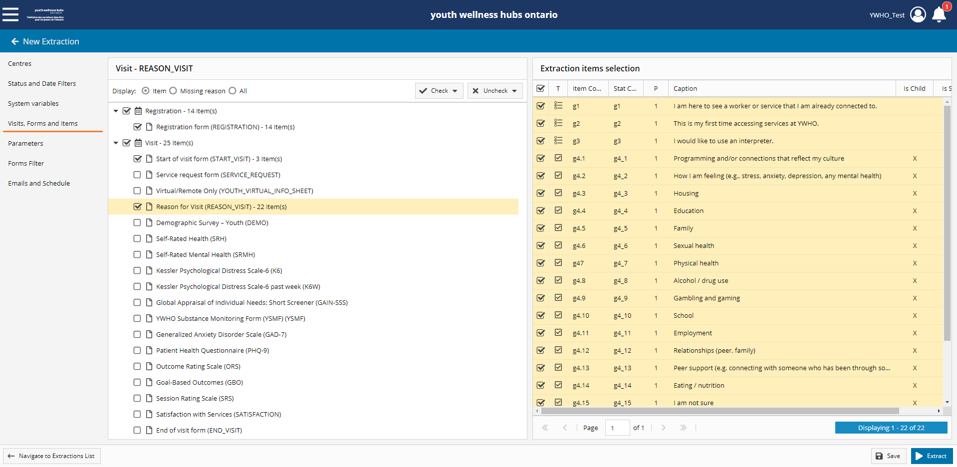
Extracting Data from MWP
Tip
  As you can see in the expanded view of the Reason for Visit, it is easier to read the different variables you can select

Slide 23
Extracting Data from MWP
Tip:
  As you can see in the expanded view of the Reason for Visit, it is easier to read the different variables you can select
  Downloading the Data Dictionary will assist in learning the various variable names
Notes:
EP to say:
Items include questions from the RfV, will review the DD in detail shortly

Slide 24
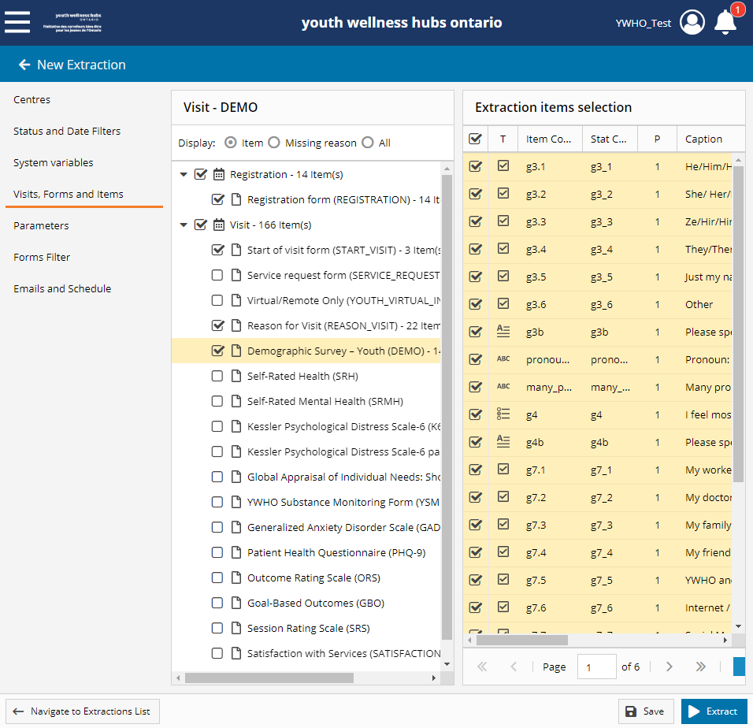
Extracting Data from MWP
Tip:
  When you select a new form, it selects all of the variables from the form
  In the Demographic Survey, there are 6 pages of variables listed – not all may be applicable to your extract

Slide 25
Extracting Data from MWP
Tip:
  When you select the top checkmark, you can select all of the variable from that page only (again, 6 pages in the Demographic form, only the first page would be selected/unselected)

Slide 26
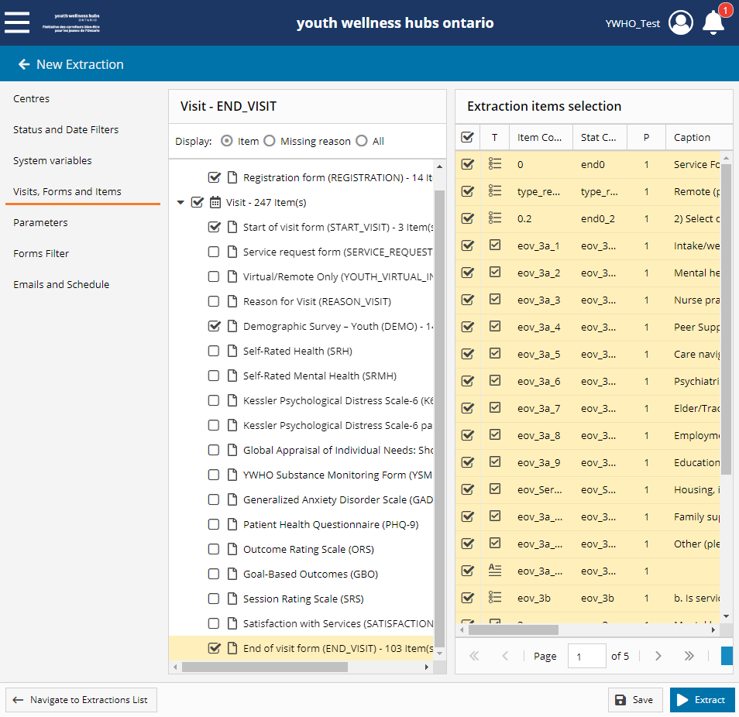
Extracting Data from MWP
The most common items extracted:
  Lastly, the End of Visit form is excellent to find out information on:
    Completion rate of the EOV
    Type of Services Provided
    Service Provider Role
    Referrals

Slide 27
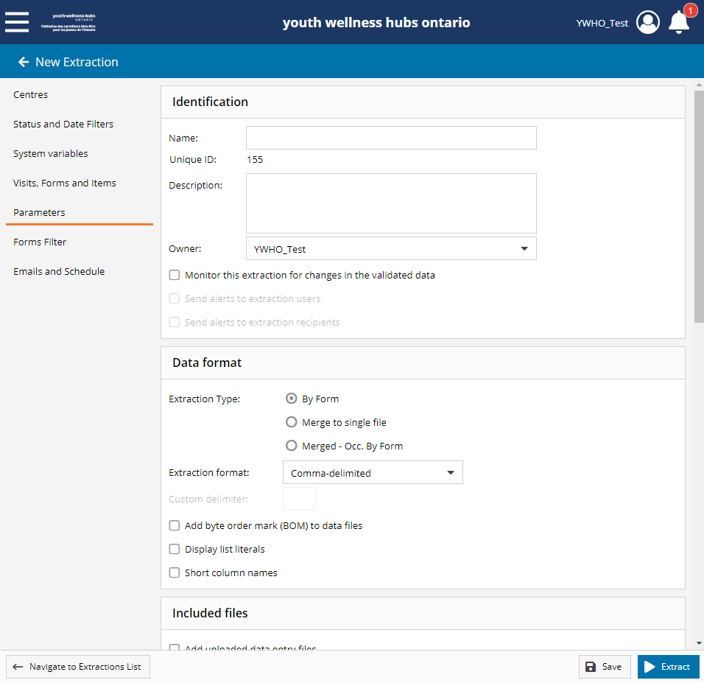
Extracting Data from MWP
In Parameters:
  You can name this extraction (useful if you want to extract the same information again) and
  Write a description of the extraction:
    Example: Youth visit with SOV & EOV for August 2022

Slide 28
Extracting Data from MWP
Tip
  Under Data format
    Merge to single file

Slide 29

Extracting Data from MWP
Tip
  Under Data format
    Merge to single file

Slide 30
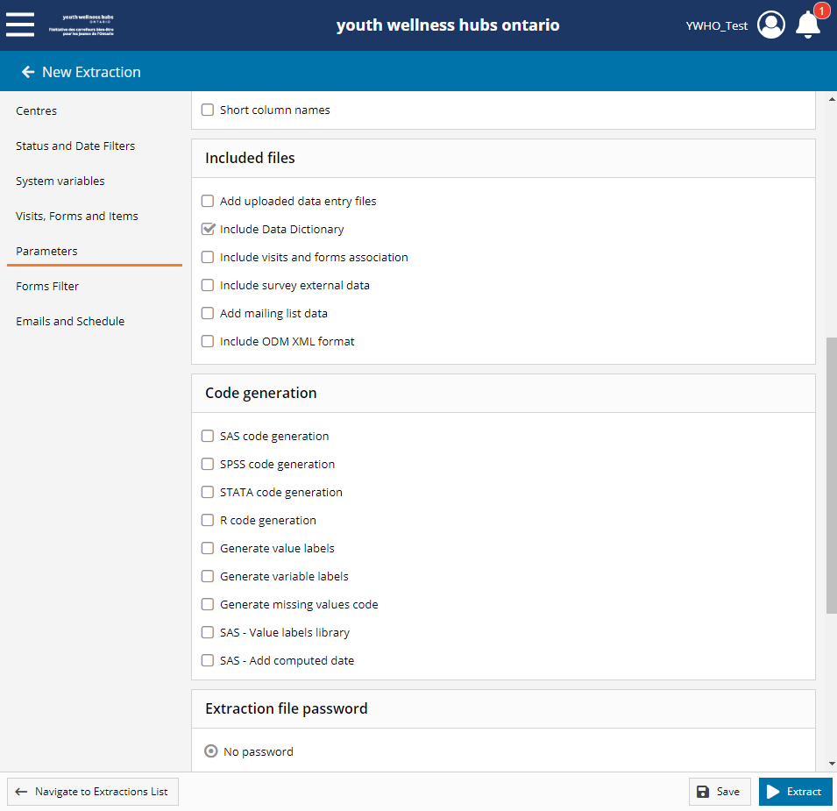
Extracting Data from MWP
Tip
  Under Included files
    Include Data Dictionary
      Need to know all column headings in your extraction

Slide 31
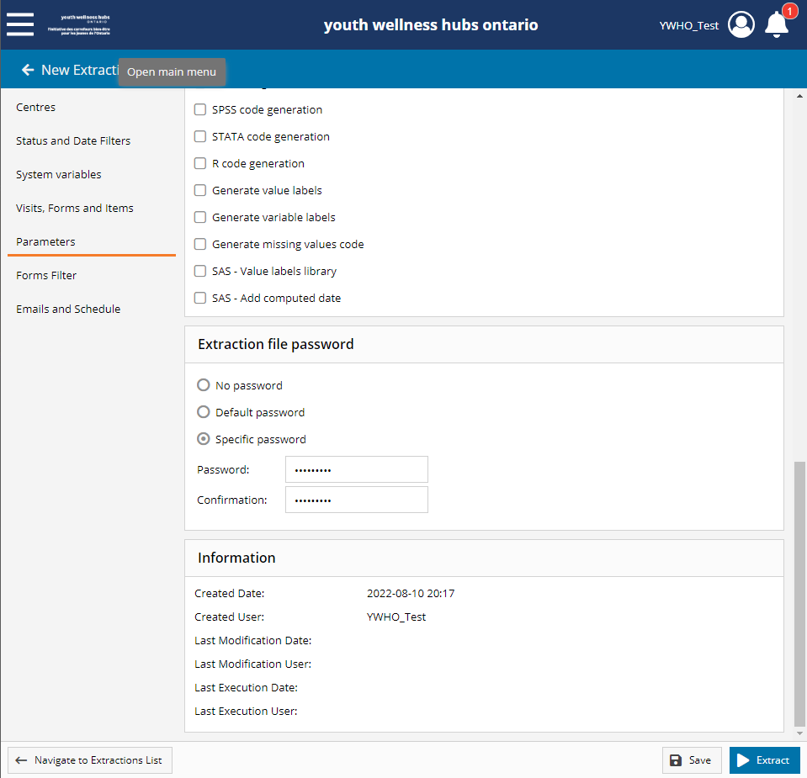
Extracting Data from MWP
Tip
  Under Extraction file password
    You can select a password for this extraction (since it will be downloaded to your download folder on your computer and may include PII information)

Slide 32
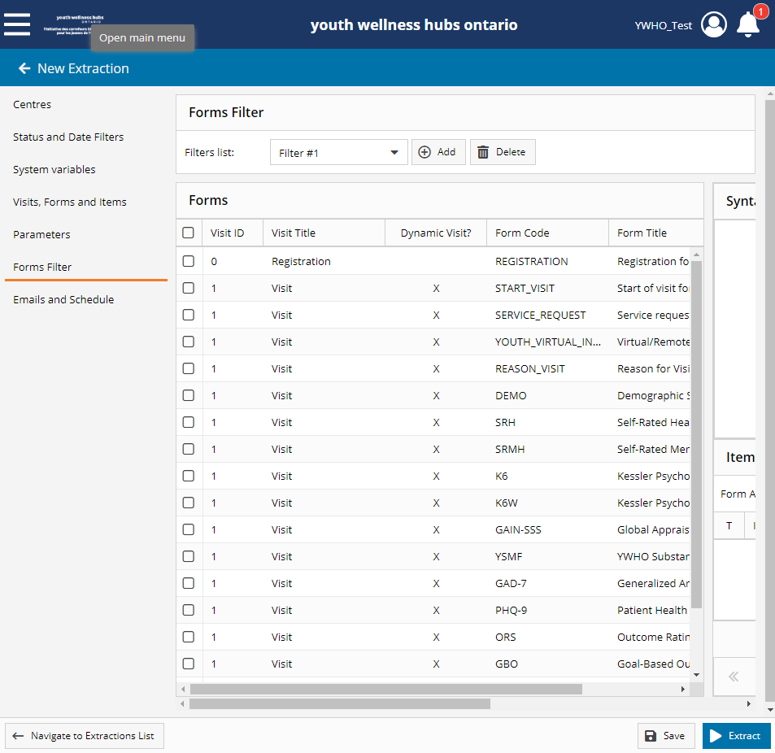
Extracting Data from MWP
Tip
  Avoid adding to Forms Filter
    Applicable to Dacima/System Administrator only with Dacima specific syntax

Slide 33
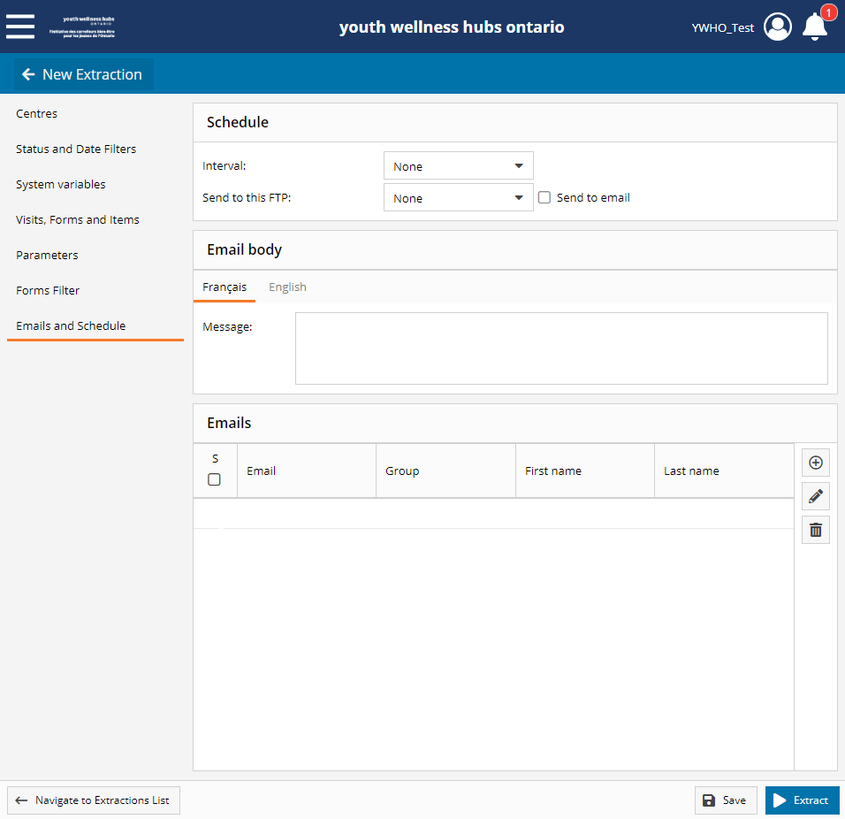
Extracting Data from MWP
  You can schedule either every day, week, or month this exact extraction
  Could be useful to see if data completion by providers on forms such as the EOV, SOV, etc.

Slide 34
Extracting Data from MWP
  Now you can save and extract your data!

Slide 35

Extracting Data from MWP
  Now you can save and extract your data!

Slide 36

Limitations to data extractions
  Improve knowledge on limitations to extracting MWP data

Slide 37
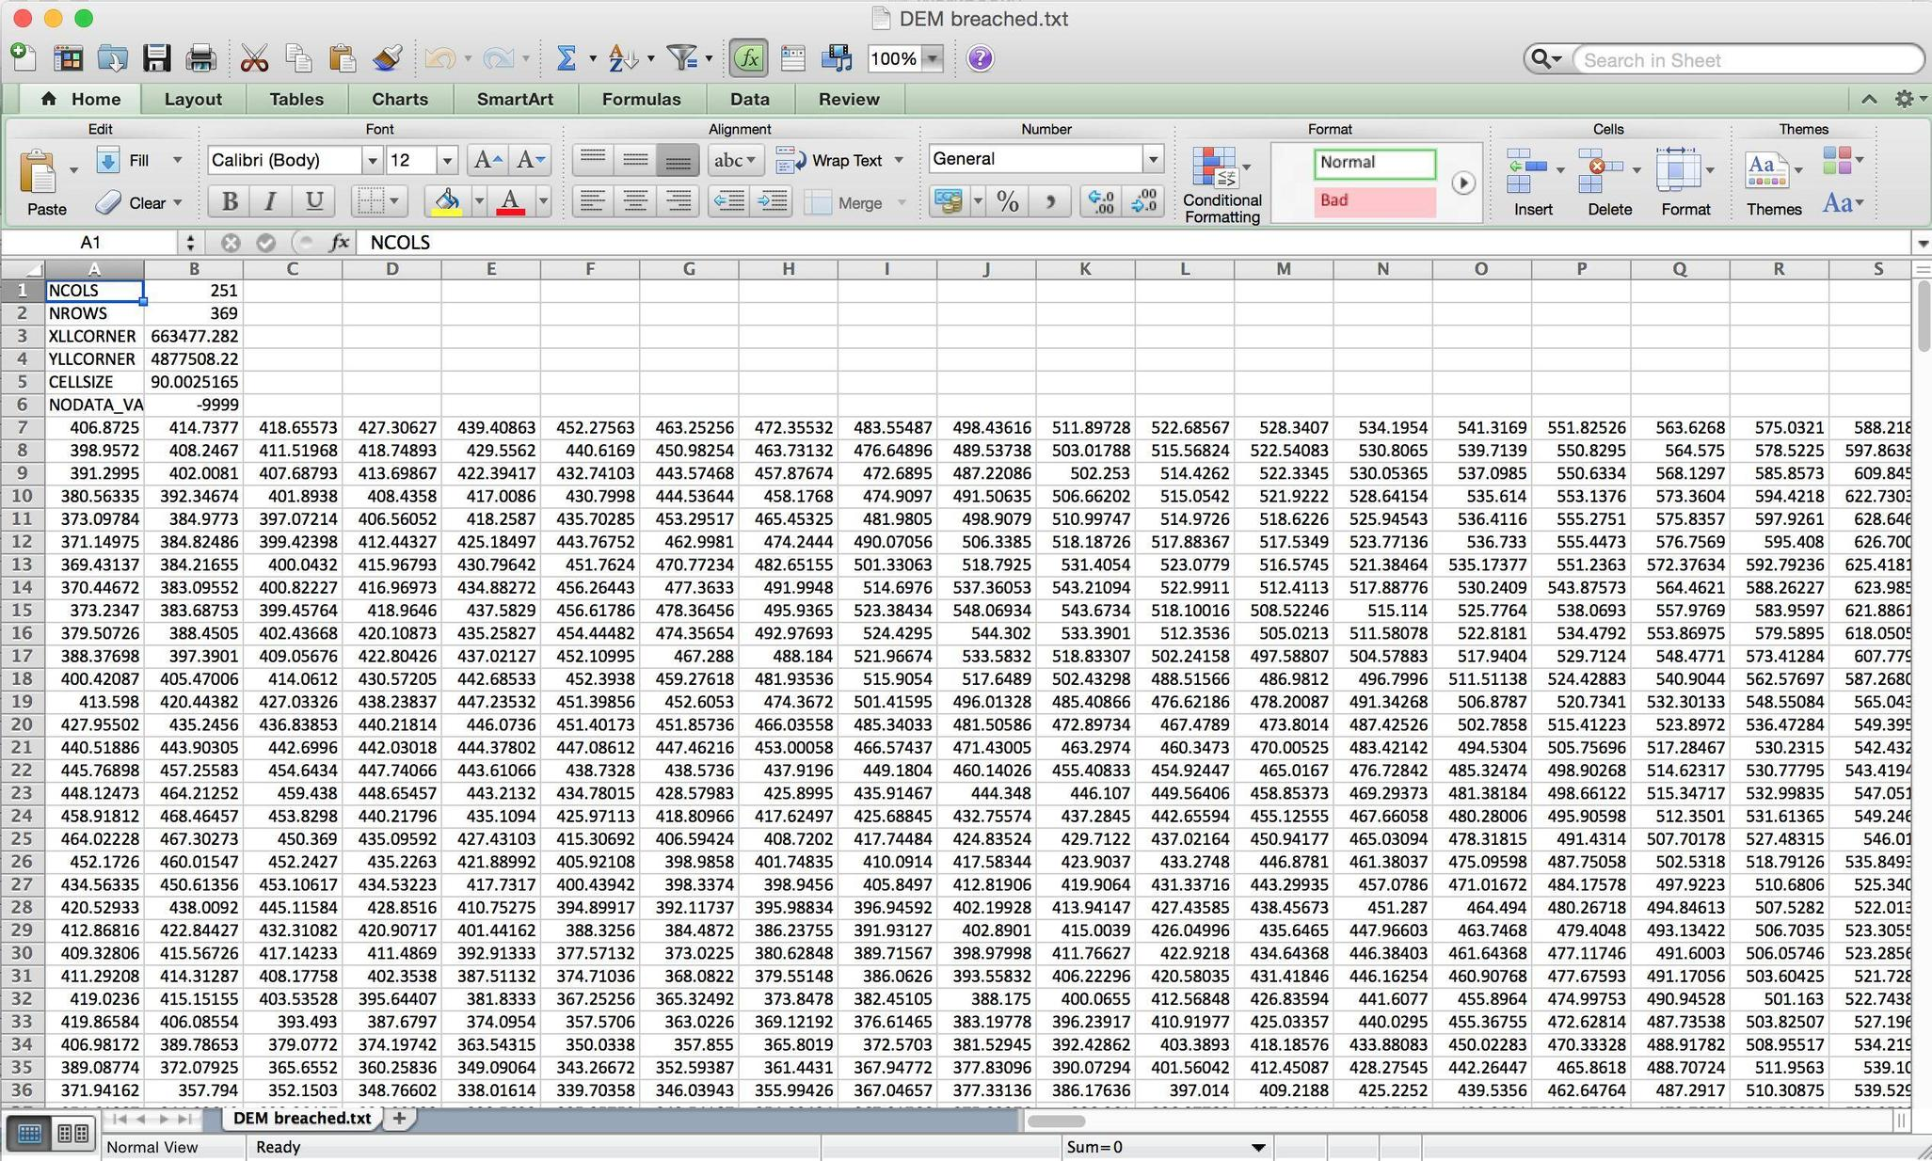
Limitations
The data extracted comes in large spreadsheets

Slide 38

Limitations
No quick numbers without modifying the data
  Need to add filters in excel
  The use of statistical software
Notes:
EP to say:

Slide 39

Limitations
The data has not been reviewed/cleaned by the YWHO PO evaluation team
Notes:
EP to say:

Slide 40

Limitations
Example: blank visits, test clients, and more possible data entry errors have not been discovered, compiled, nor cleaned
Notes:
EP to say:

Slide 41

Limitations
Examples:
Missing Date of Births means you cannot know if that youth can count within certain age categories

Slide 42

Limitations
Examples:
Test Clients can skew data

Slide 43

Data Requests

Slide 44

Data Requests
Moving forward, YWHO is providing hubs monthly data reports. Sites recently received their data for last fiscal. Annotations were provided to support data interpretation.

Slide 45
Data Requests
Data coaching is available through the evaluation team upon request.

Slide 46
Data Requests
Data requests should be sent to mwp@ywho.ca. An evaluation team member will respond within two days, with a final solution expected within two weeks of the request.

Slide 47
Data Requests
Data request template will be available soon.
Notes:
EP to say:

Slide 48

Thank
You!
Notes:
EP to say:

Slide 49

Questions?

Slide 50





Connect with YWHO
@ywhontario
@ywhontario
@ywhontario
youthhubs.ca

